Slide 1
Summer
Youth Events
Summer 2012

Slide 2
InterMission
When: Saturday, April 28th, 2012
Time: Starting at 5:15 PM
Where: Rochester- Pax Christi Parish
Who: 8th-12th Graders
What: Youth Mass, Dinner, Adoration, a Dance
Note: Since it is a long drive and a short event, we will not be attending as a group, but if you want more information let us know!

Slide 3
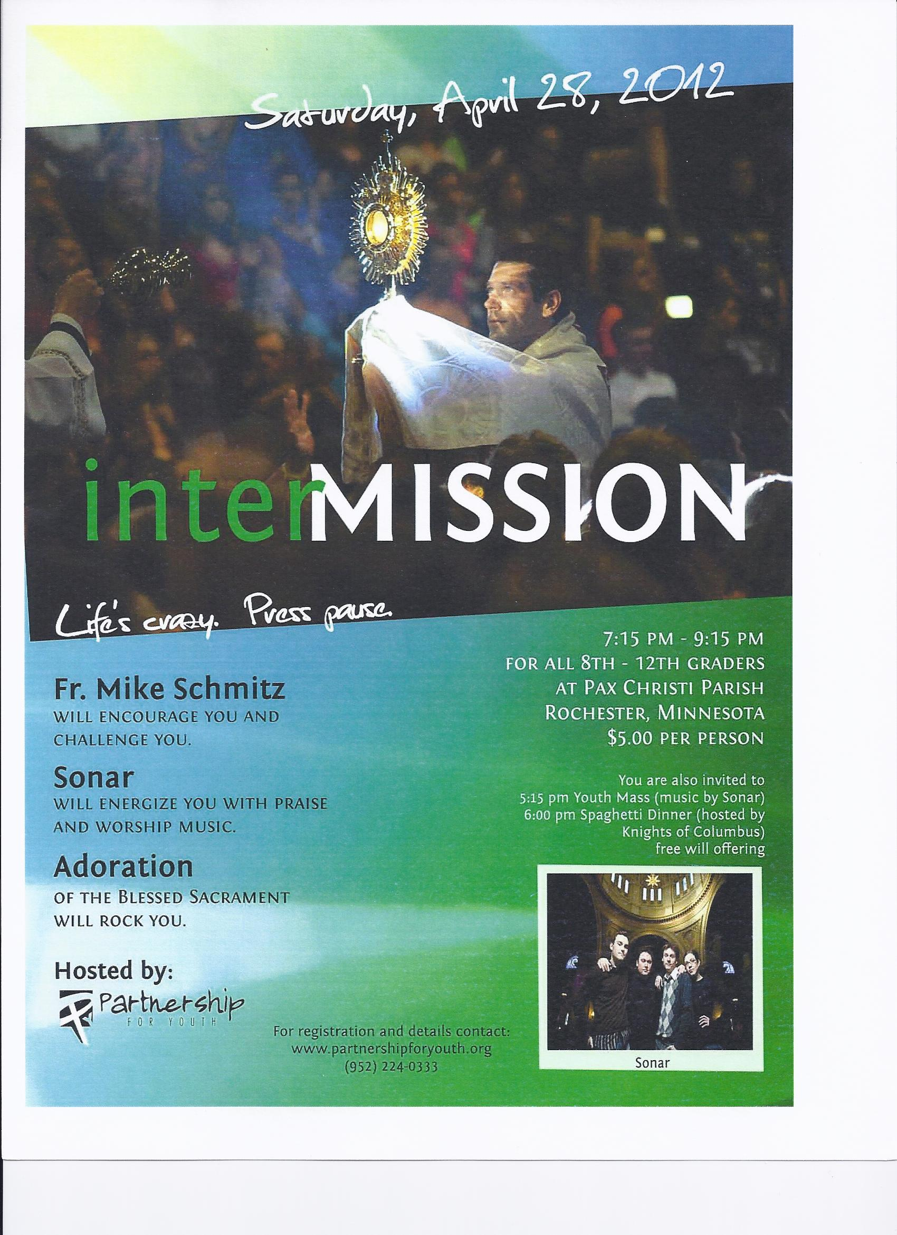

Slide 4
Quo Vadis Days
Who: Young Men Grades 9-12
When: June 12-15th, 2012
Where: IHM Seminary, Winona
What it means: “Where Are You Going?”
Why go: To discover more about your faith, the possibility of a vocation into the priesthood, and to have fun with friends
Brochures are available to sign up today!

Slide 6
Turning Our Gaze to Christ
Who: Anyone! Literally.
Bring the whole family!
When: June 22-23, 2012 Attend one or both days!
Where: Rochester- Mayo Civic Center and St. John the Evangelist Parish
What is it: A way to learn more about the Catholic faith and how to defend it!
Register online at www.dow.org

Slide 8
Steubenville North “THE EI8HTH DAY”
Who: Current 8th-12th Graders
When: July 13-15, 2012
Where: Rochester- Mayo Civic Center
What: A gathering of thousands of students from across the Midwest and Canada who want to experience God in a whole new way!
Why go: It’s fun! You don’t have to explain why you like Adoration cause everyone understands. ☺ Seriously fun and life changing! ☺

Slide 9
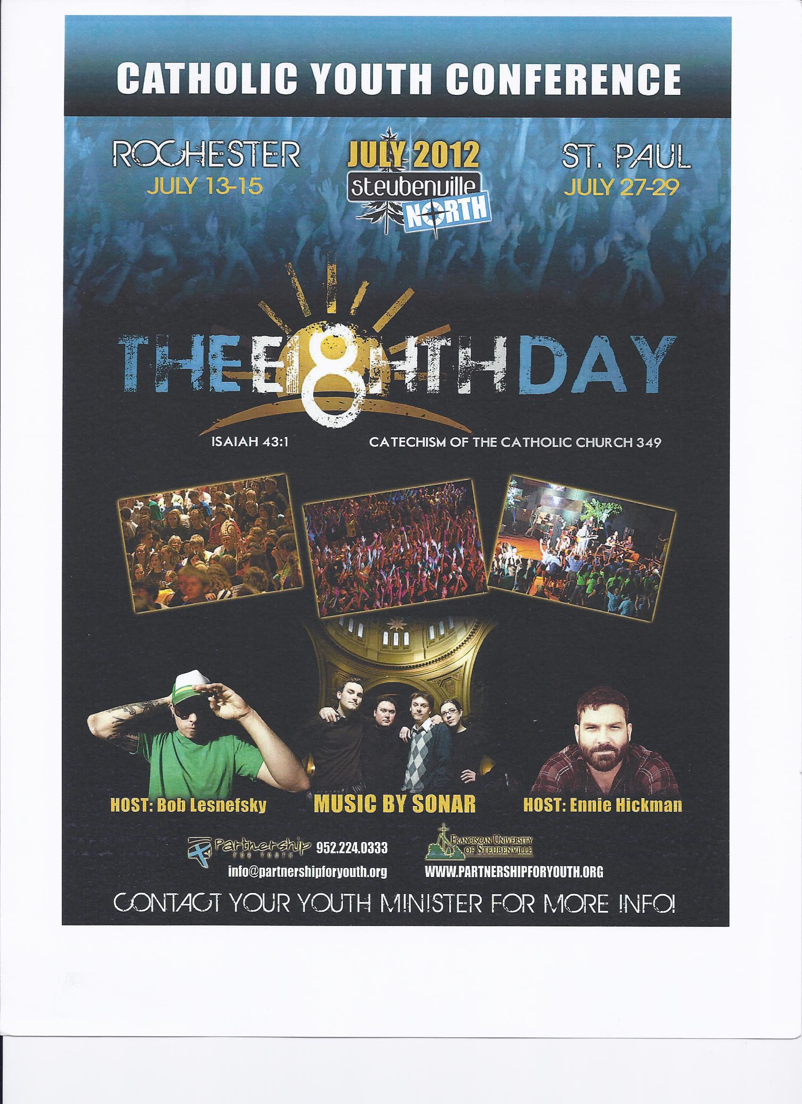
Sign
Up
Today!
www.partnershipforyouth.org

Slide 10
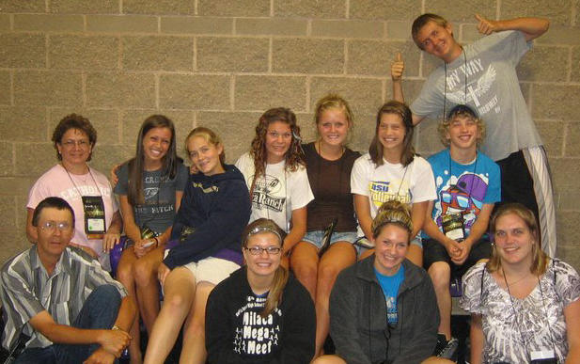
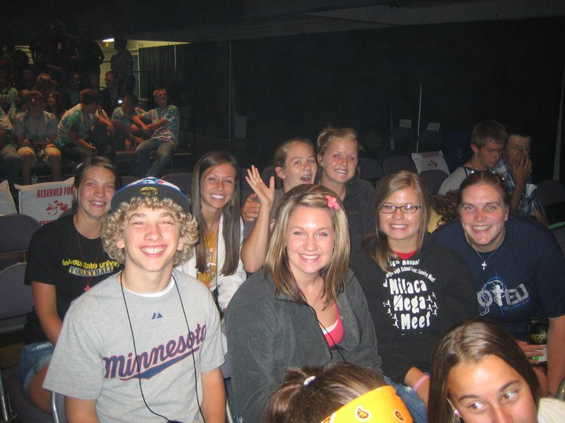
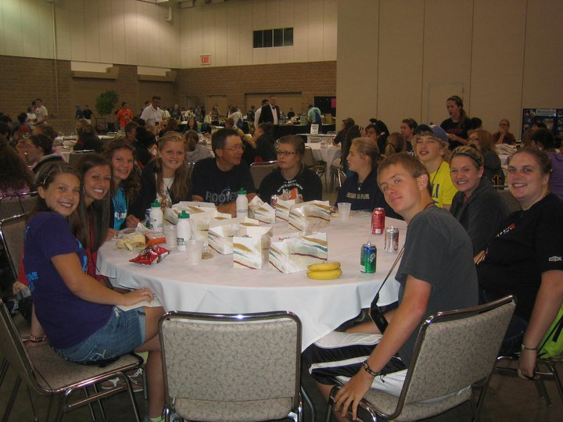
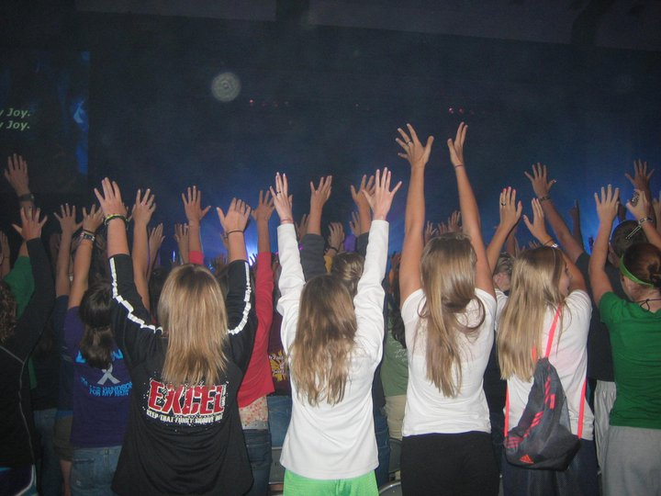
Steubenville North- Rochester
THE EI8HTH DAY

Slide 11
Totus Tuus
When: July 16-20 for grades 1-6 from 9-2:30
July 15-19 for grades 7-12 from 7:30-9:30
Where: Our Lady of Good Counsel, Wilmont
What: Summer program to help students “grow in the understanding of, and strengthen their faith in, Jesus Christ.”
This program is designed for grades 1-12 and we would love to see everyone participate!

Slide 12
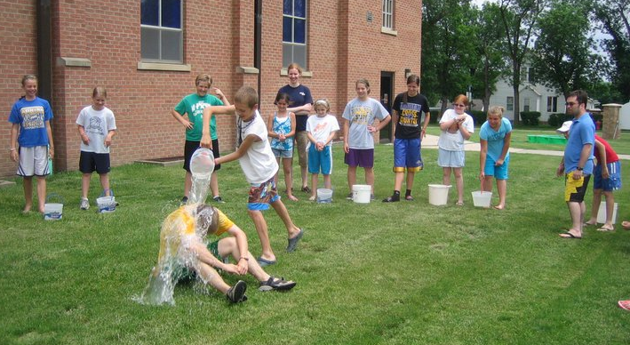
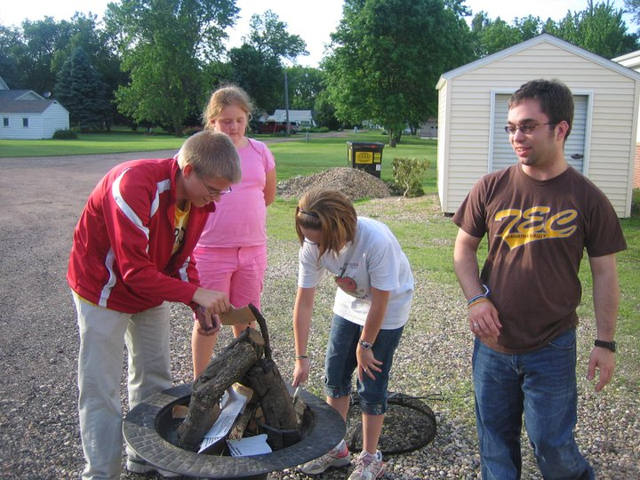
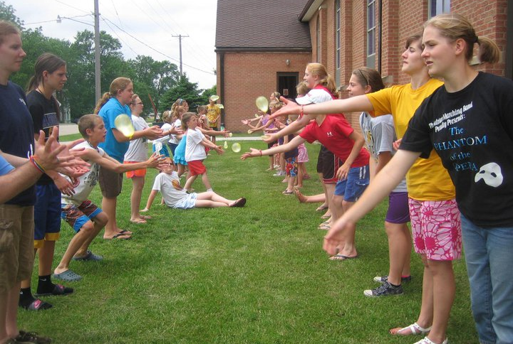
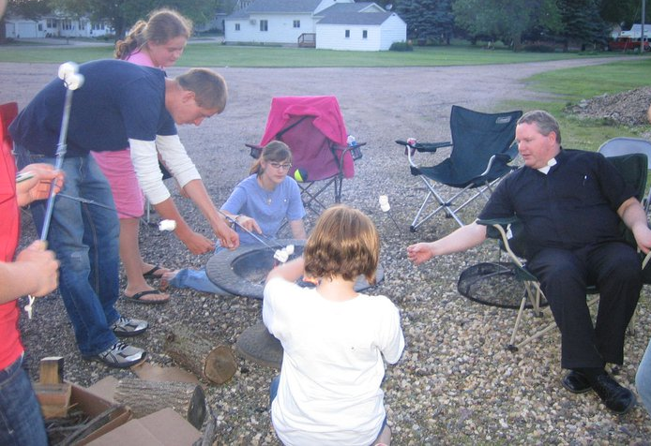
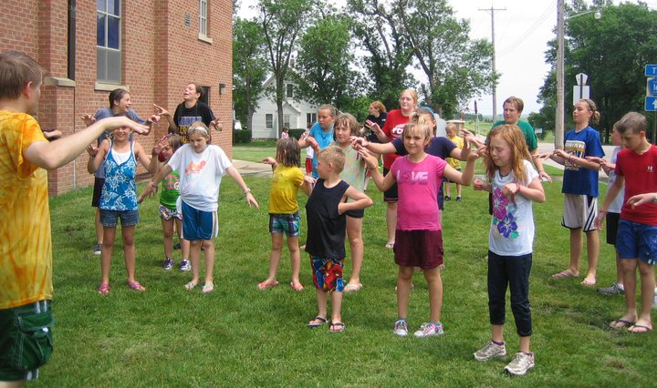

Slide 13
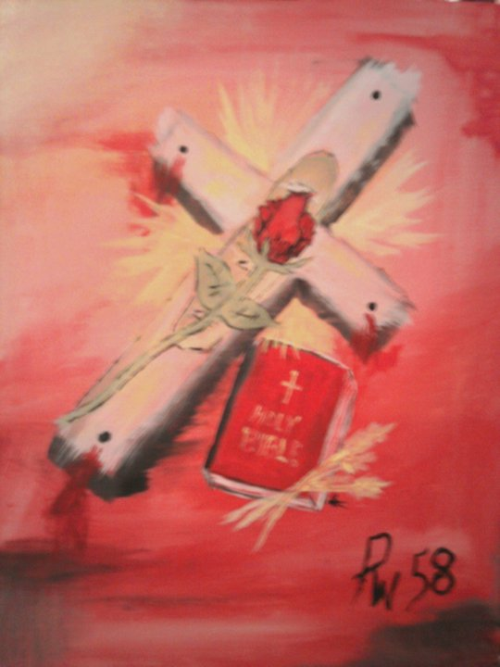
Who: Anybody 16 years and older
What: Three Day Spiritual Retreat
When: July 20-22, 2012 and October 19-21
Where: Rochester in July, Mankato in October
Why: To experience the love of God in a whole new way with others your age

Slide 14
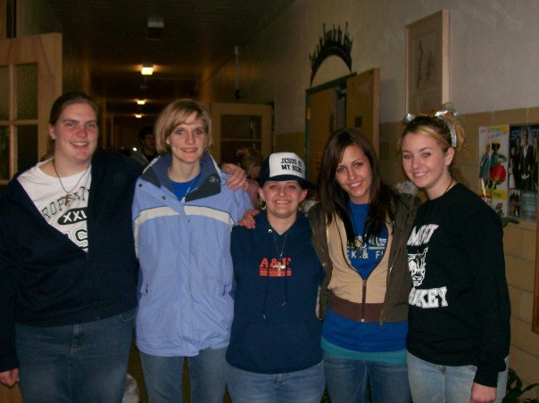
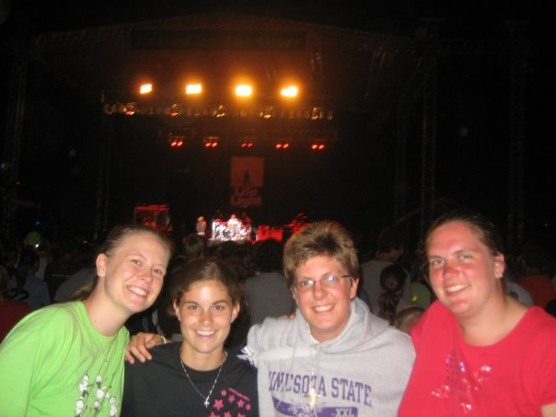
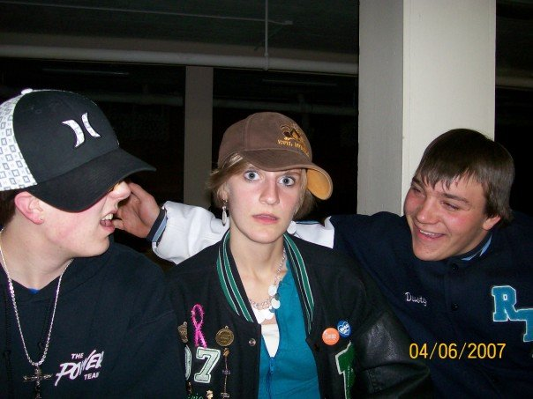
Top Left: Leaving TEC
Top Right: Lifelight
Still Friends
Bottom Left: Good Friday get together with TEC friends
Point: You make friends for LIFE!!

Slide 15
DCYC (Diocesan Catholic Youth Conference)
When: This Fall
Where: Mankato
More details to come but make plans to go because it is close and lots of fun!!

Slide 16
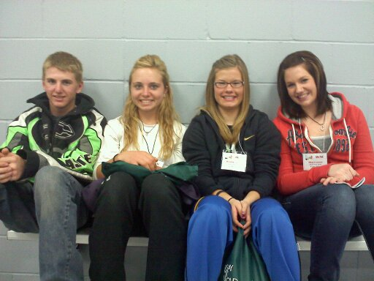
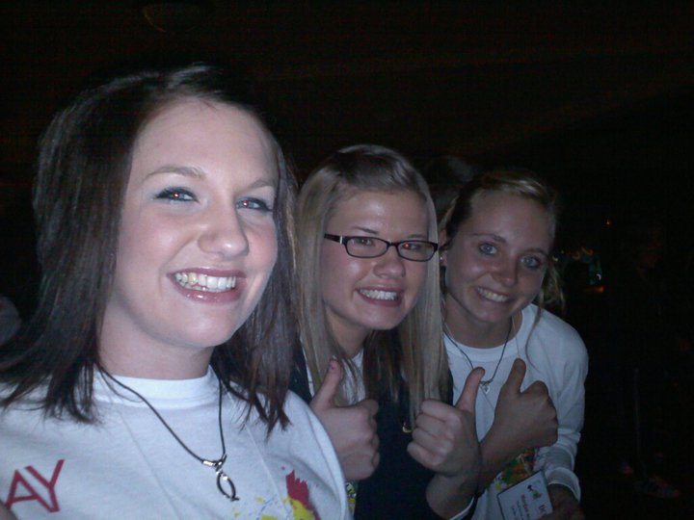
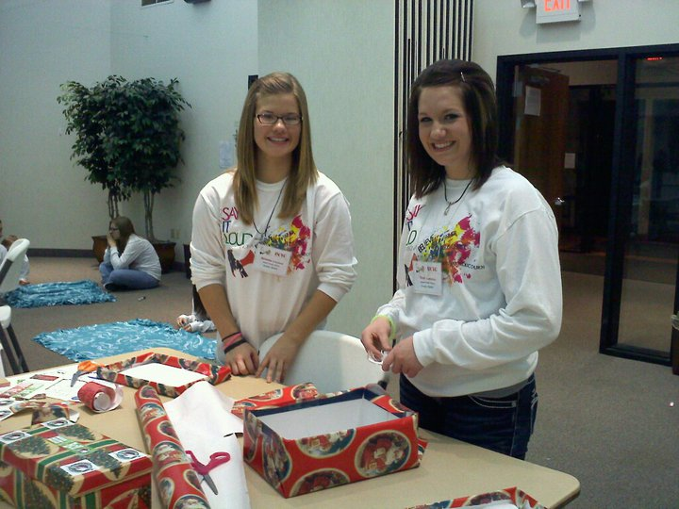
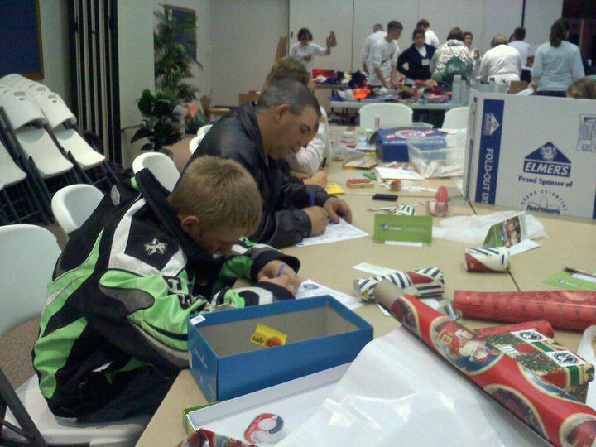

Slide 17
World Youth Day 2013
Who: YOUNG ADULTS Ages 18+
Where: Rio de Janeiro, Brazil, South America
When: July 20-30, 2013
Why: What’s better than seeing hundreds of thousands of people from hundreds of countries across the world come together to worship our living GOD?!
Mark it on your calendars and start saving today!

Slide 19
Preguntas?
If you have any questions contact Pam, Leslie, or Shannon.
We can testify to the “fun factor” of all the events!
Please sign up today!!
Forms and online registrations are available.
Don’t just sit around doing nothing all summer!

